Slide 1
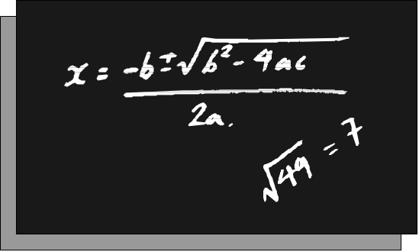
Chapter 2
Basic Reliability Models
The Failure Distribution
Chapter 2
Notes:
The study of reliability begins by defining the basic a the mathematical functions that are used to describe the failure distribution. These functions include the reliability function, the cumulative distribution function, the density function, and the hazard rate function. In addition, the mean, median, mode, standard deviation, and variance of the failure distribution are defined. Understanding the nature and use of these functions is fundamental to mastering reliability modeling.

Slide 2
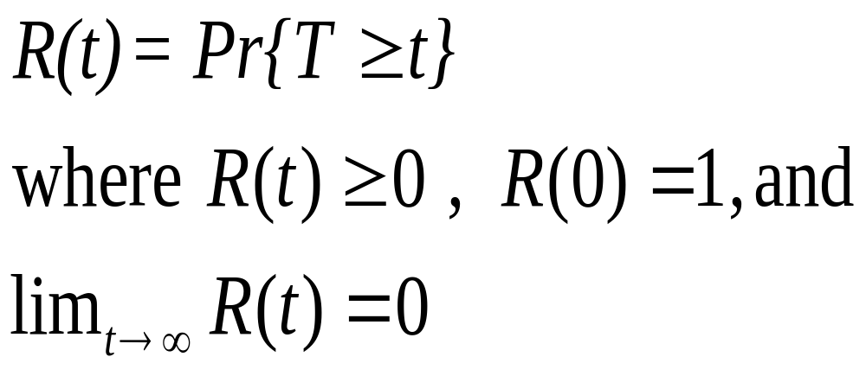
The Reliability Function
Let T = a random variable, the time to failure of a component
Often called the SURVIVAL FUNCTION
Chapter 2
Notes:
The failure distribution is defined in terms of the random variable T = the time to failure. The probability that a failure occurs after some time ‘t’ is defined to be the reliability at time t and notationally is written as R(t). Simply stated, this the probability that the component or system will survive at least until time t. A reliability function must be non-negative with the reliability at t = 0 equal to one. For t sufficiently large, R(t) = 0. That is, eventually the component must fail. Some textbooks will refer to the reliability function as the survival function reflecting its medical heritage.

Slide 3
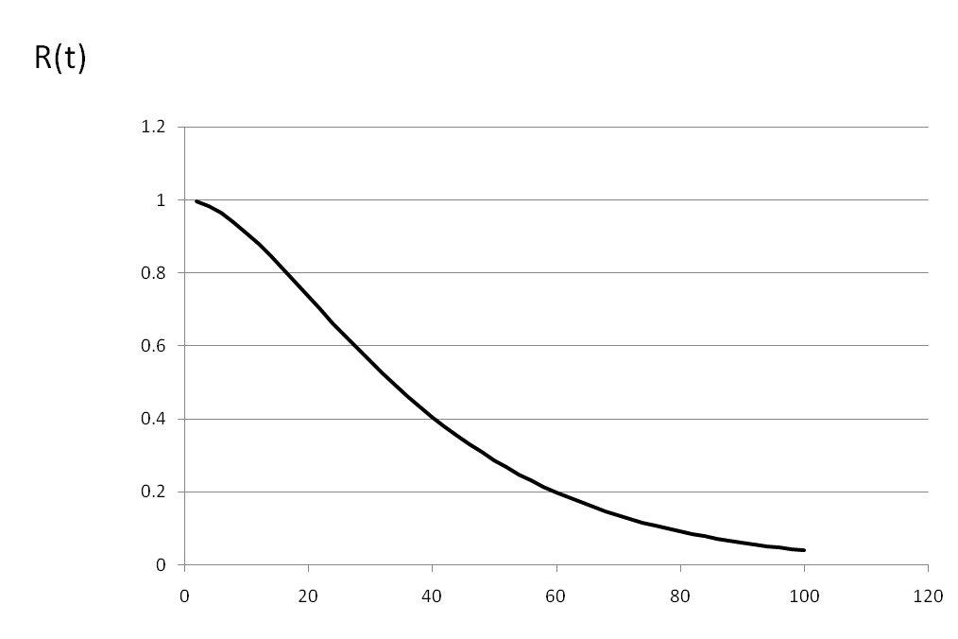
Graph of a Reliability Function
Probability of surviving
Chapter 2
Notes:
The typical reliability function will have a graph similar to the one shown. The function is always monotonically decreasing. Why?

Slide 4
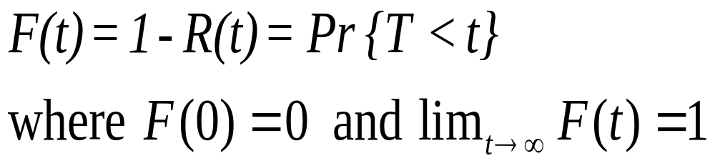
The Cumulative Distribution Function (CDF)
Chapter 2
Notes:
A companion function to the reliability function is the Cumulative Distribution Function (CDF). The very same CDF you studied in your probability course. It gives the probability that a failure will occur by time t. Since a failure must occur either before time t or at or after time t, then F(t) + R(t) = 1 for any value of t. F(t) may be referred to as the failure function.

Slide 5
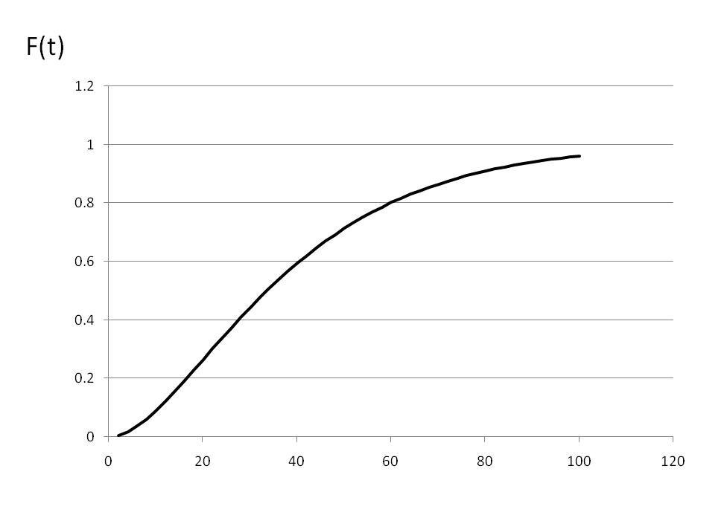
Graph of a CDF
The probability of a failure
Chapter 2
Notes:
The CDF will have a graph similar to one shown above. It is a monotonically increasing function. This implies that the longer a component operates, the greater the probability of a failure. The CDF asymptotically approaches one while R(t) asymptotically approaches zero.

Slide 6
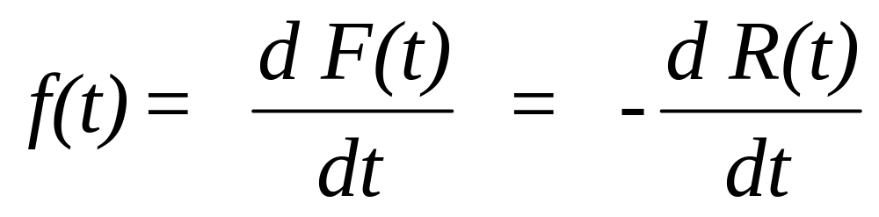
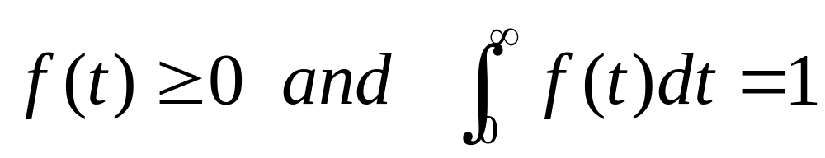
The Density Function (PDF)
Chapter 2
Notes:
A third related function is the probability density function (PDF). The PDF when graphed provides the most common representation of the shape of the failure distribution. For example, the graph of the PDF for the normal distribution has the familiar bell-shaped curve. The PDF has two important properties: it is always non-negative and the area under its curve equals one. Given F(t) or R(t), the PDF is easily derived by taking a first derivative.

Slide 7
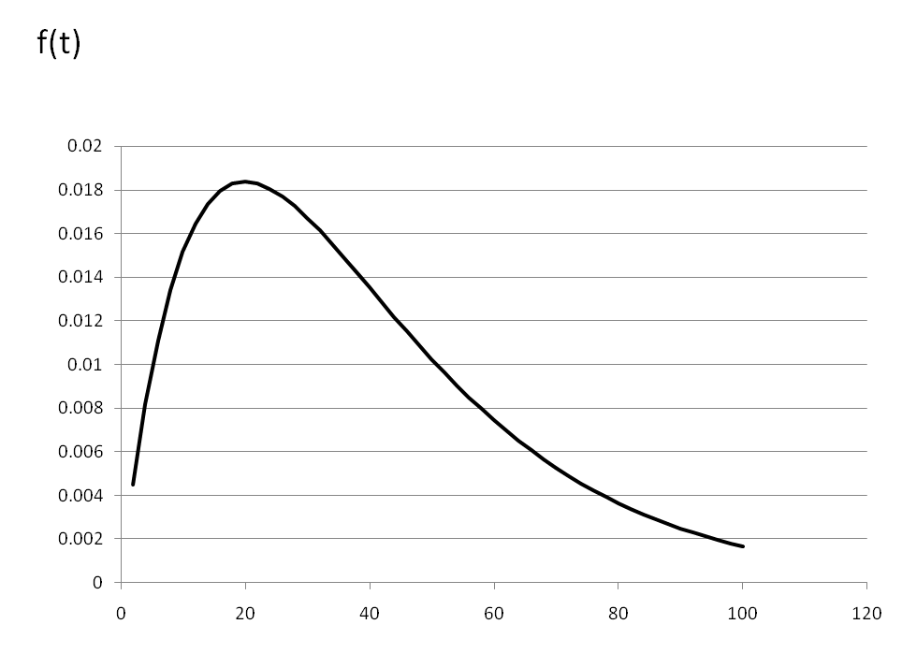
Graph of a Density Function (PDF)
Chapter 2
Notes:
The PDF can take on various shapes. The one shown here is only one possibility. It may be skewed or symmetrical. It may be uniform, unimodal, bimodal, or neither. It may be defined over the entire non-negative domain of T or T may have a finite upper bound. In either case, the area under the curve will always equals one and any portion of the area between say, t₁ and t₂, is the probability of a failure occurring within that time interval.

Slide 8
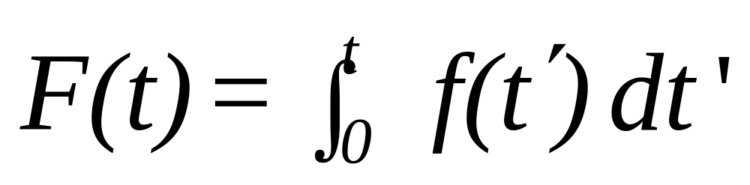
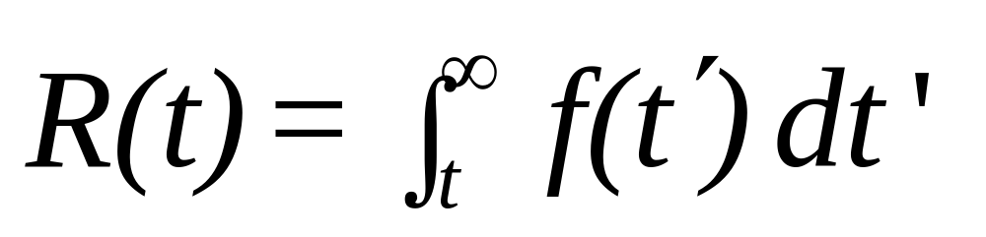
Relationship between PDF and CDF
Chapter 2
Notes:
If we start with the PDF as given, either the reliability or the failure function can be derived through integration. If the random variable T has a finite upper bound, say b, then R(t) is found by integrating from t to b rather than t to infinity. By the way, a finite upper bound b implies that the component or system must fail by time t = b.

Slide 9
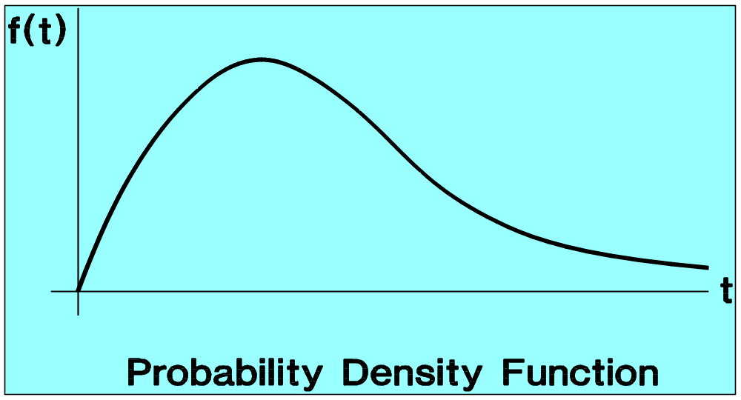

Finding Failure Probabilities
Pr{a
T
b} = R(a) - R(b)
= F(b) - F(a)
a
b
Chapter 2
Notes:
Continuing with the PDF, f(t), the probability of a failure occurring in the interval [a,b] is equal to the definite integral evaluated between a and b. If either R(t) or F(t) is known, the integration has already been done, and this same probability can more easily be found.

Slide 10
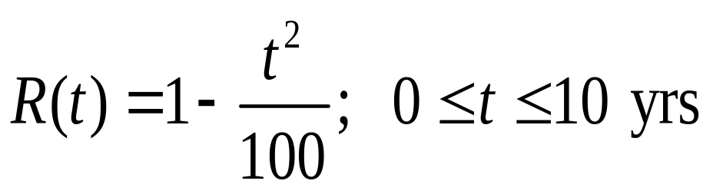
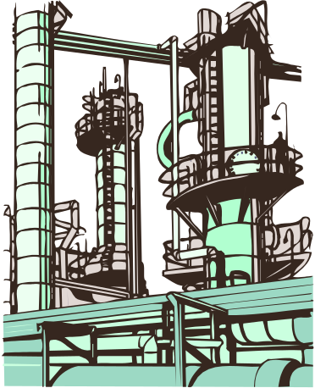
Example
The passive components of a distribution system for natural gas has the following reliability function:
Find: a. R(3 yrs)
b. The CDF, F(t)
c. Pr{1<T<3}
d. The density function, f(t)
Chapter 2
Notes:
Work the above example to test your understanding of these concepts. The solution is given on the next slide.

Slide 11
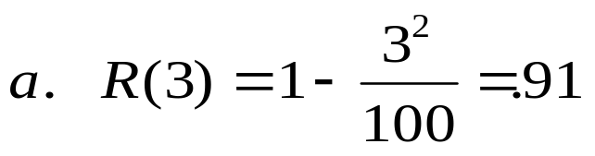
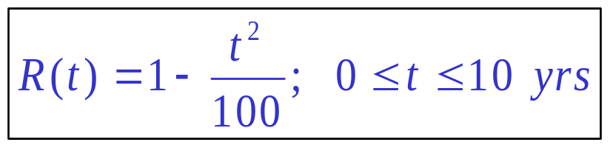
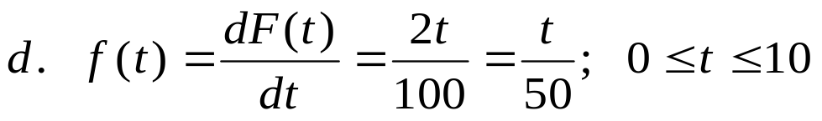
Example - solution
b. F(t) = 1 - [1 - t² / 100] = t² / 100
c. Pr{1<T<3} = F(3) - F(1) =. 09-.01 =. 08
f(t)
10
t
Chapter 2
Notes:
If you missed part of this exercise, then go back and review the concepts. If you had difficulty with the mathematics, then you may need to review some algebra or calculus.

Slide 12
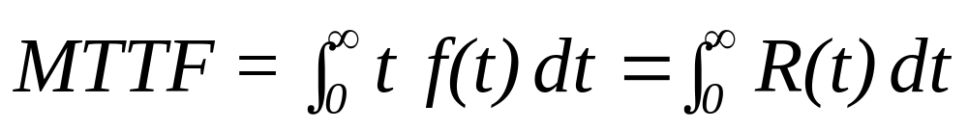
Mean Time to Failure (MTTF)
Note alternate notation: MTTF = E[T]
Chapter 2
Notes:
An important concept in reliability is the Mean Time to Failure (MTTF). This is nothing more than the mean of the failure probability distribution and is found in the same way that any mean or expected value, E[T}, of a random variable is found. For continuous distributions, the mean is defined as the integral of tf(t) integrated over the domain of the random variable. It turns out that the MTTF may also be found by integrating the reliability function over the domain of the random variable as well. Would you like to try and prove this? If not, its derivation is provided in Appendix 2A of the text and displayed on the following slide.

Slide 13
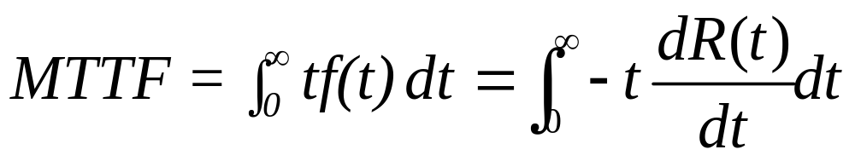

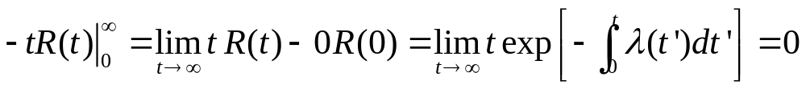
Derivation of MTTF (Appendix 2A)
Integration by parts:
Since
Chapter 2
Notes:
This derivation makes use of integration by parts. You may fondly recall from your calculus days solving problems using this technique. Do not worry, you will not be asked to replicate this proof. However, you should be able to use the resulting formula. For some distributions, the MTTF is more easily found by integrating R(t) rather than t f(t).

Slide 14
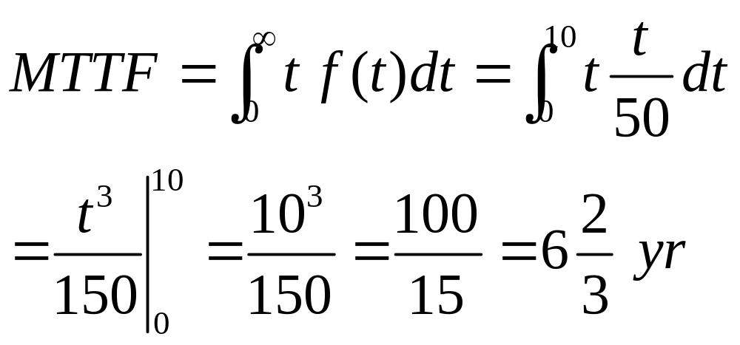
Example - MTTF
For the distribution system, find the MTTF.
Chapter 2
Notes:
Here is the same failure distribution as before with its MTTF determined.

Slide 15
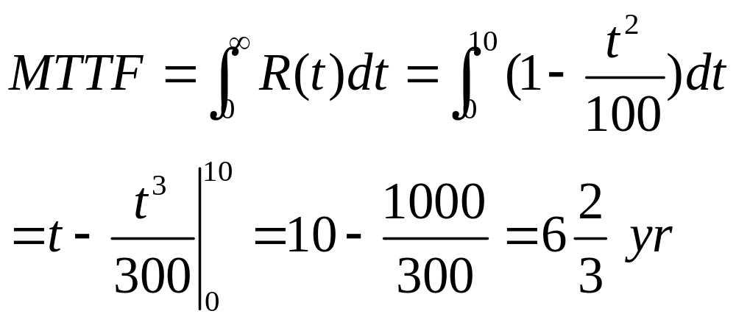
Example - MTTF revisited
For the distribution system, find the MTTF.
Chapter 2
Notes:
Here is the same failure distribution as before with its MTTF determined.

Slide 16
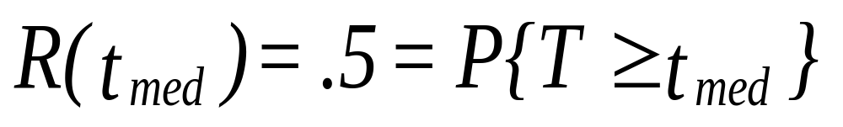
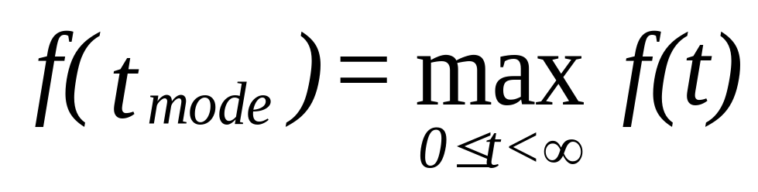
Median Time to Failure and Mode
Chapter 2
Notes:
The MTTF is a type of weighted average and as such is not always the most representative failure time. The question we are attempting to answer, is what is the most typical time to failure. If the distribution is symmetrical, then the answer may be the MTTF. However, if the distribution is skewed, then another measure of central tendency may be more representative of the entire collection of failure times. The median is often used when distributions are skewed. The median time to failure is that failure time that splits the distribution into two halves where 50 percent of the failures will occur before the median and 50 percent will occur at or after the median time to failure. A third measure of central tendency is the mode or the most likely failure time. It is defined mathematically as the value of t that maximizes f(t) assuming f(t) is unimodal. For a unimodal function, if a unit interval of time is centered at the mode, then the probability of a failure occurring within that interval of time is greater than any other unit interval. Can you show this graphically?

Slide 17
Example - median and mode
R(t) = 1 - t² / 100 = .5
t² /100 = .5
t² = 50 or t_{med} = 7.07 yrs
f(t)
by inspection
t_{mode} = 10 yrs
10
t
Chapter 2
Notes:
Continuing with the same failure distribution, the median and mode are determined. A mode can occur at an end point of the distribution.

Slide 18
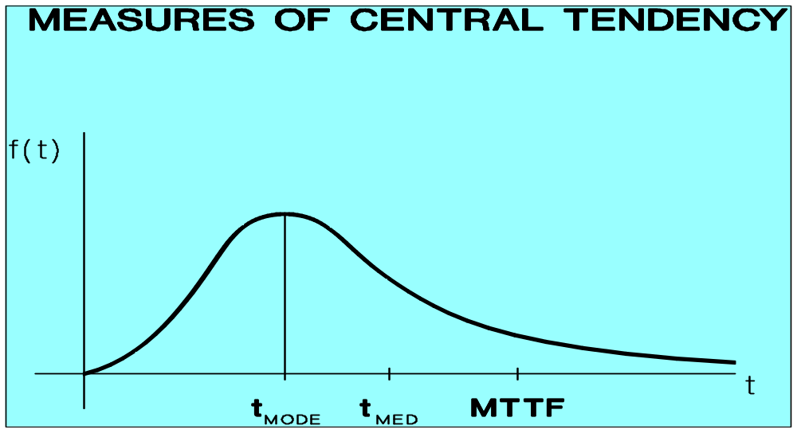
Comparison of MTTF, Median, & Mode
Chapter 2
Notes:
For a distribution that is skewed somewhat to the right, the mean (MTTF), median, and mode will typically appear in the relative positions shown.

Slide 19

Design Life
Find t_{R} such that R(t_{R}) = R
For example:
Find that time, t_{.99} such that R(t_{.99}) = .99
Then t_{.99} is the 99 percent design life.
One percent will fail before time t_{.99}
Chapter 2
Notes:
Using R(t), we can find the reliability at a given time t. The problem can also be worked in reverse. Give a reliability, R, find the corresponding t, call it t_{R}. Then t_{R} is referred to as the design life. That is, it is the length of time that the component can operate at a specified reliability, R.

Slide 20
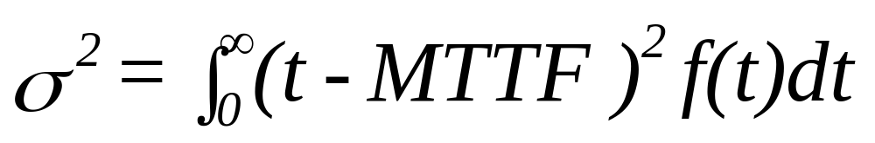
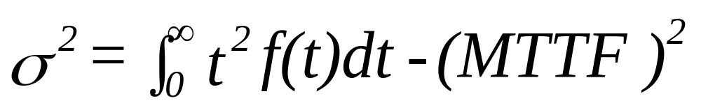
Variance & Standard Deviation
definitional form:
computational form:
Chapter 2
Notes:
A failure distribution has all of the characteristics that any probability distribution has. Therefore is has a variance and standard deviation. The variance may be found using either of the forms shown. Loosely speaking, the variance is the weighted average squared distance a failure is from the MTTF. As such, it is a measure of the dispersion or spread of the failure distribution. The larger the variance, the more dispersed will be the individual failure time from the MTTF. For distributions having a large variance, the mean or median may not be a very representative failure time although it may still, in some sense, provide a “center point” for the distribution.

Slide 21
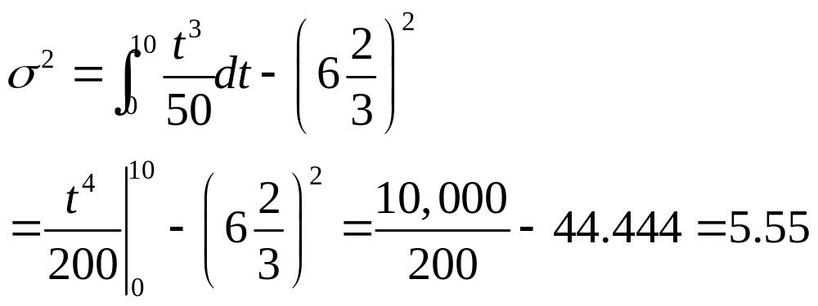
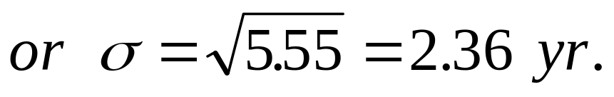
Example - standard deviation
Chapter 2
Notes:
Again with the example, find the variance. The square root of the variance is the standard deviation. The standard deviation is somewhat more useful than the variance since it will be in the same units as the random variable where as the variance is in squared units. If the time to failure is measured in hours, then the standard deviation will be measured in hours and the variance will be measured in hours squared.

Slide 22
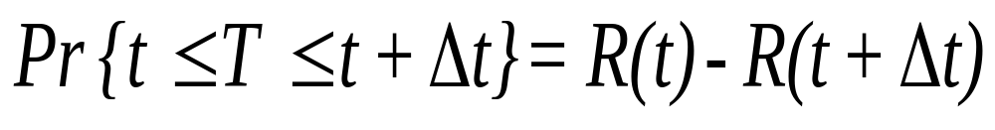
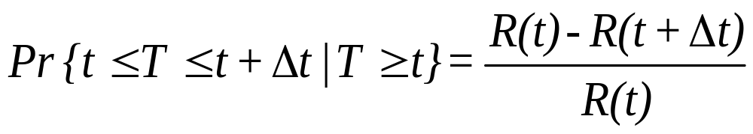
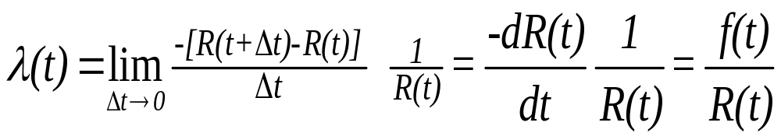
Hazard Rate Function
Chapter 2
Notes:
The fourth major function of a failure distribution is the hazard rate function. This function is sometimes called the instantaneous failure rate function. It is derived by finding the conditional probability of a failure occurring in small some interval of time given that the component is still operating at the start of the interval. Since the interval may start at any time t, the hazard rate function become a function of time as well and be found by forming the ratio of f(t) / R(t). It is important to understand the meaning of the hazard rate function as a conditional probability.

Slide 23
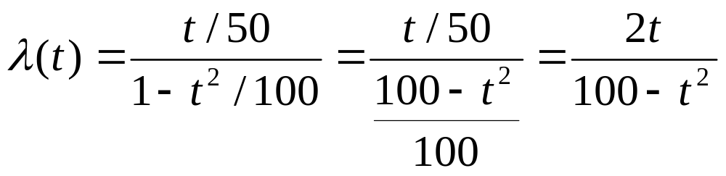

Example - hazard rate function
(t)
IFR
t
10 yr
Chapter 2
Notes:
Let us find the hazard rate function for our example. If we plot the hazard rate, we can see that it is monotonically increasing. This suggest that the probability of a failure occurring in the next instant of time is continuously increasing as the component ages. Failure distributions having this characteristic are referred to as having an Increasing Failure Rate (IFR).

Slide 24
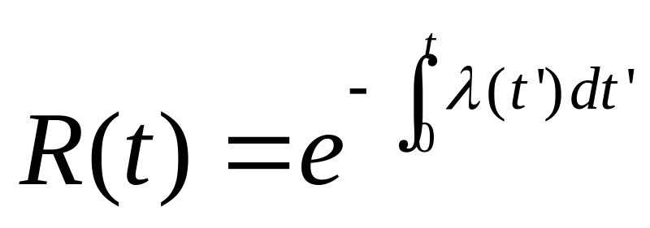
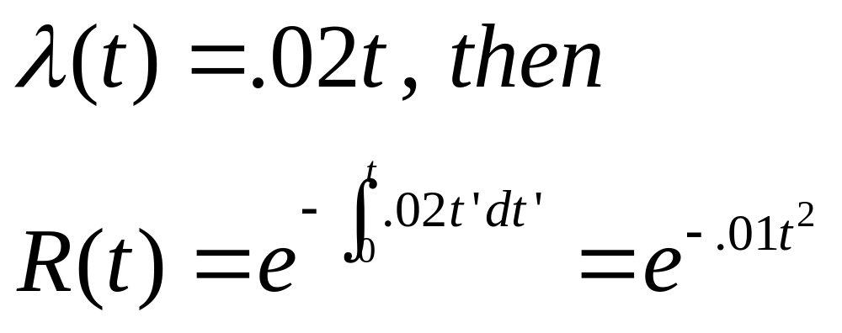
Hazard Rate Function & R(t)
Example:
Chapter 2
Notes:
Given R(t), we can find f(t), and then using f(t) and R(t) derive λ(t). If we start with λ(t), this formula allows us to derive R(t). The next slide shows its derivation. When using this formula, be careful to find the definite integral first and then use the negative of its value as the exponent with e as the base.

Slide 25
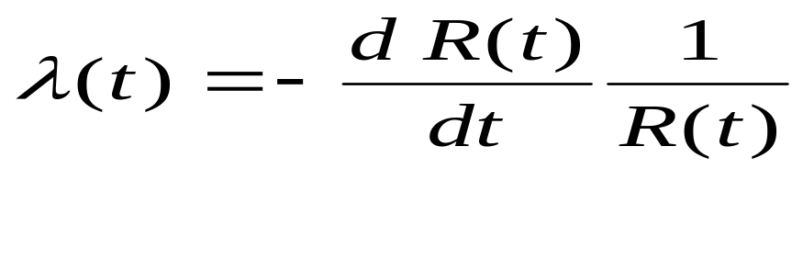
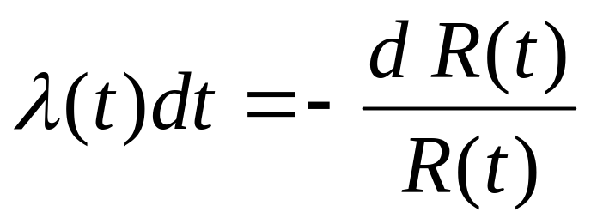
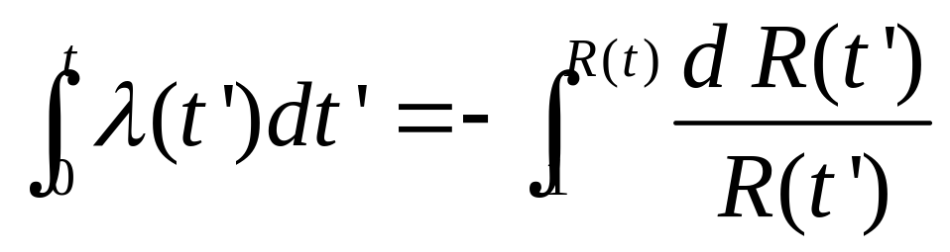
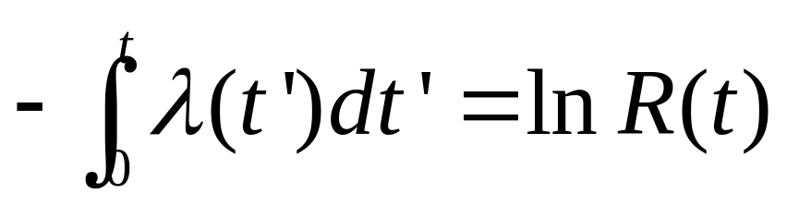
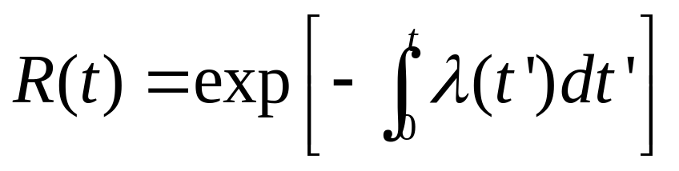
Derivation of R(t) from the Hazard Rate Function
Chapter 2
Notes:
Here is that derivation that I promised you. You will not need to repeat it; however, you should be able to use the resulting relationship.

Slide 26
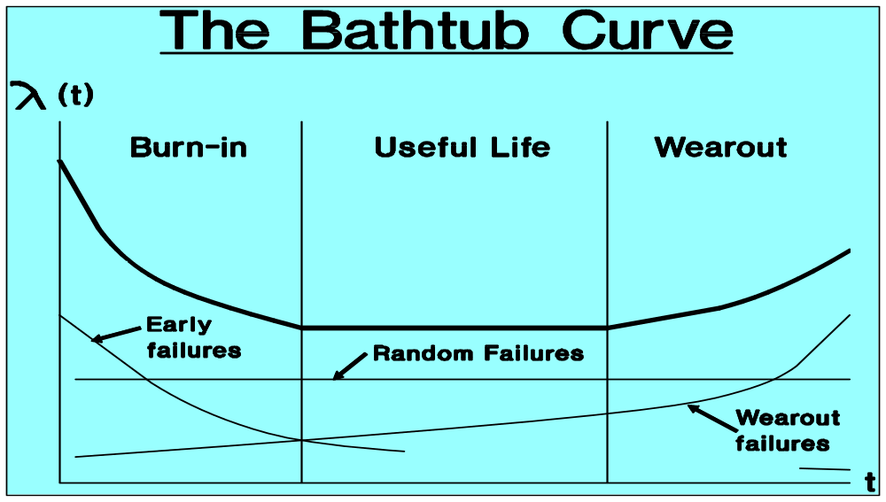
The Bathtub Curve
Chapter 2
Notes:
A well known plot of a hazard rate function is the bathtub curve. It obviously gets its name from its shape. It suggests that for some items, early or infantile failures occur that decrease (DFR) with age as design and manufacturing problems are recognized and corrected. This is followed by a period of nearly Constant Failure Rates (CFR) in which most failures are a result of external random occurrences. Can you suggest what probability distribution may best describe this period? Finally, as the component ages and wearout begins to dominate, an IFR is observed. It is not clear how many components actually behave in this manner. Certainly some do. All three failure modes may be continuously present; however, the dominate failure mode depends upon the age of the component.

Slide 27
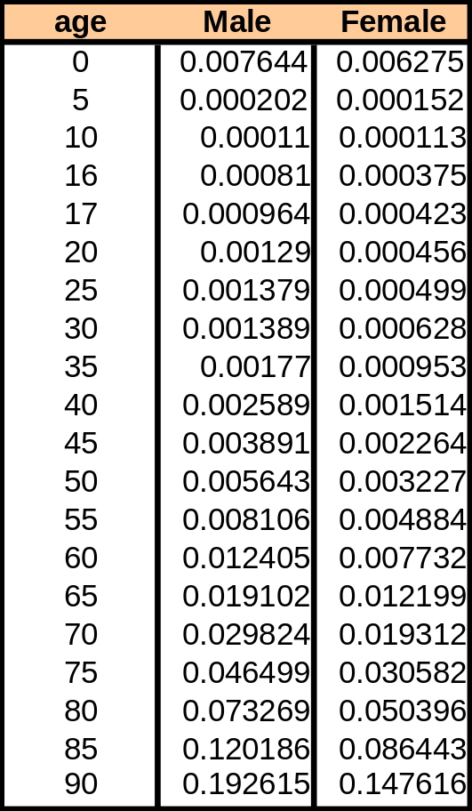
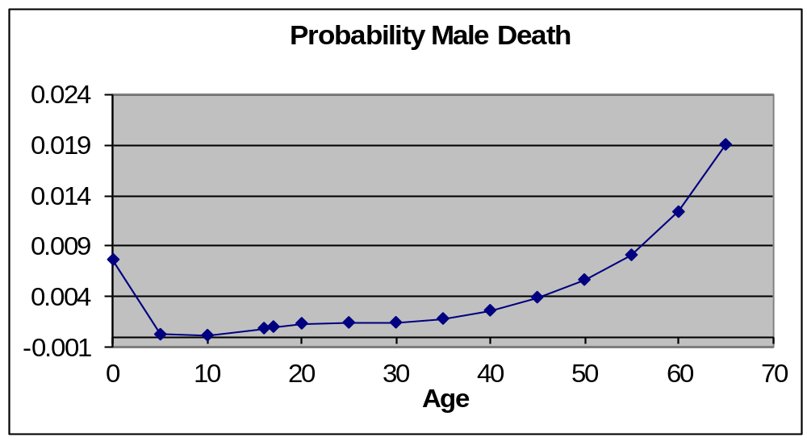
Human Mortality Curve
Chapter 2

Slide 28

More on the Bathtub Curve
Burn-in Useful Life Wearout
Characterized by DFR CFR IFR
Caused by Manufacturing defects Environment Fatigue
Welding flaws, Cracks, Random loads Corrosion Defective parts, Poor Human error Aging
quality control, "Acts of God" Friction
Contamination, Poor Chance events Cyclical loading workmanship
Reduced by Burn-in testing Redundancy Derating
Screening Excess strength Preventive Maint.
Quality control Parts replacement
Acceptance testing Technology
Chapter 2
Notes:
Some more insight on the bathtub curve. The design techniques used to mitigate failures will be discussed in more detail later.

Slide 29
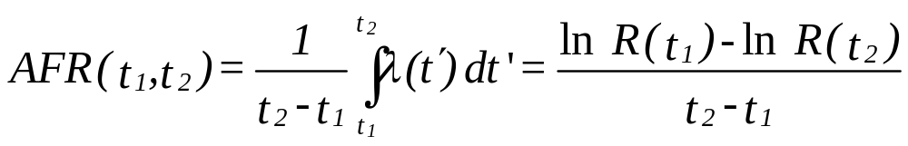
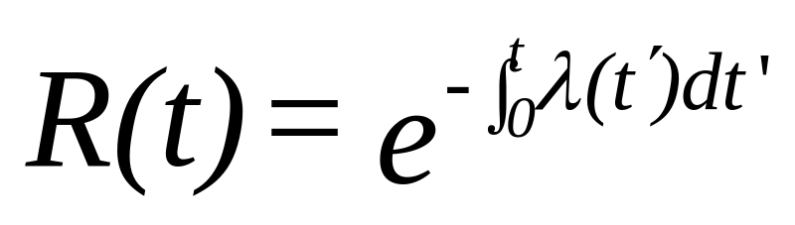
Average Failure Rate (AFR)
since:
Note: AFR(0,t) = AFR(t) = -ln R(t) / t
Chapter 2
Notes:
For failure distributions that have either IFR and DFR characteristics, the failure rate (hazard rate) is a function of time and is continuously changing. For comparison purposes, it is sometimes useful to compute an average failure rate for some interval of time. This way, two components having different failure distributions can be compared based upon their average failure rate over the same time interval.

Slide 30
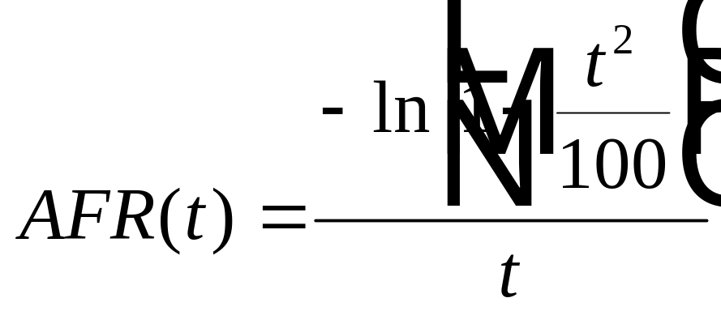
Example - Average Failure Rate
AFR(5 yr) = - ln [1 - .25] / 5 = .0575 failures / yr
Chapter 2
Notes:
Let’s find the average failure rate for our example.

Slide 31
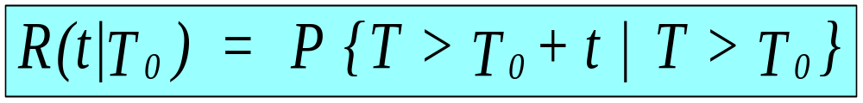
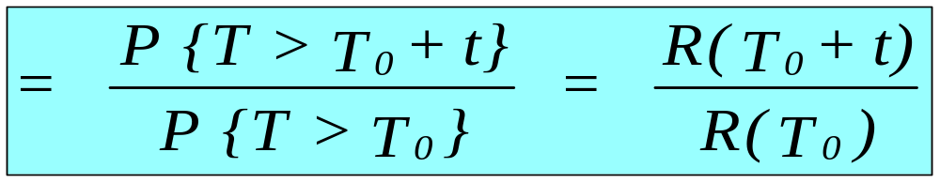
Conditional Reliability
Event A
Event B
Chapter 2
Notes:
Another useful concept is conditional reliability. Conditional reliability is the probability that a component will survive to time T₀ + t given that it has survived to time T₀. In other words, given that the component has aged to time T₀ how likely is it that it will continue to operate for an additional time t. A conditional reliability can be found by forming the ratio of two unconditional reliabilities. Do you see how this result is obtained by using some basic rules of conditional probabilities? Conditional reliabilities are useful in analyzing equipment burn-in periods and manufacture warranty periods.

Slide 32
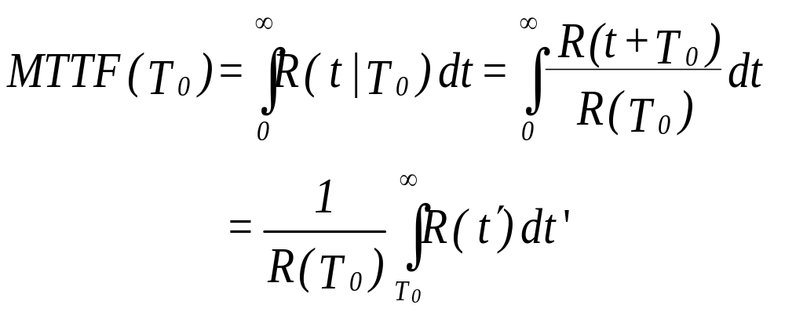
Residual MTTF
where t’ = t + T₀
Chapter 2
Notes:
Using the conditional reliability function, a conditional or residual MTTF can be found. This is interpreted as the mean remaining life of a component that has aged to time T₀. You should understand how to use this formula; however, the definite integral must often be found numerically.

Slide 33
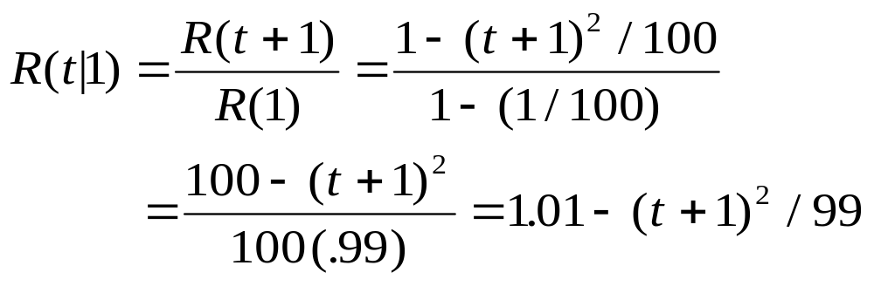
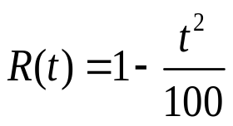

Example - conditional reliability
Therefore: R(5|1) = 1.01-36/99=.646
where R(5) = 1 - .25 = .75
Chapter 2
Notes:
For our example, we can easily compute a conditional reliability and, at least in this case, solve for the residual MTTF. How does the MTTF(1 year) compare to the unconditional MTTF? Does this make sense?

Slide 34


Residual MTTF(T₀)
Chapter 2

Slide 35

Student Exercise #1
A panel consisting of analog displays has a reliability function given by
R(t) = (200-t)/200 for 0 < t < 200
where t is measured in 1000’s of hr. Find:
a. R(50,000) and R(12,000)
b. R(50,000 | 12,000)
c. MTTF
d. MTTF(12,000)
Chapter 2
Notes:
At last, an exercise for you to work. The solution is given on the next slide but don’t look until you have tried to solve it first.

Slide 36


Student #1- solution
a. R(50) = (200 - 50)/200 = .75
R(12) = (200 - 12)/200 = .94
b. R(50|12) = R(62) / R(12) = (200 - 62) /200 / .94= .69 / .94 = .734
Chapter 2
Notes:
Did you get the correct answers? If not, go back and review the material that was missed. If you had trouble with the math, review some algebra and calculus. If you don’t understand the solution, contact your instructor.

Slide 37
Student Exercise #1 (continued)
e. What is the shape of the density function?
f. Is the hazard rate function increasing or decreasing?
g. Compute the average failure rate over the first 100,000 miles.
Chapter 2
Notes:
Some more of Exercise #1.

Slide 38

Student Exercise #1-solution
e. f(t) = -dR(t) /dt
= - d {(200-t)/200}/dt =1/200
f(t)
t
200
t
200
g. AFR(100) = - ln {(200-100)/200} / 100
= .007 failures/ 1000 mi.
Chapter 2
Notes:
Did you get the correct answers this time? If not, go back and review the material that was missed. If you had trouble with the math, review some algebra and calculus. If you don’t understand the solution, contact your instructor.

Slide 39

Student Exercise #2
Insulators on a power distribution system have a reliability function with t measured in yr.
R(t) = 1 / (1 + .05t) where t >= 0
Find:
a. F(1 yr) and R(2)
b. R(2|1)
c. The hazard rate function
(optional)
d. AFR(3)
Chapter 2
Notes:
Let’s try a second example.

Slide 40

Student Exercise #2 - solution
a. F(1) = Pr{T<1} = 1 - 1/[1+.05(1)] = 1 - .9524 = .0476
R(2) = Pr{T>2} = 1/[1+.05(2)] = .9091
b. R(2|1) = Pr{T>3 | T>1} = R(3) / R(1)
= [1+.05(3)]⁻¹ / .9524 = .913
c. f(t) = -d [1+.05t]⁻¹ /dt = .05[1+.05t]⁻²
λ(t) = f(t)/R(t) = .05/[1+.05t] which is DFR
d. AFR(3) = {-ln [1+.05(3)]⁻¹ } / 3
= -ln .8696 /3 = .0466 failures per year.
Chapter 2
Notes:
Isn’t it getting easier?

Slide 41

Summary - The Four Functions
f(t), the Probability Density Function (PDF)
F(t), the Cumulative Distribution Function (CDF)
R(t), the Reliability Function
λ(t), the Hazard Rate Function
Chapter 2
Notes:
At this point, given any one of the above functions, you should be able to derive the other three (assuming you can do the math). At a minimum, understand these four functions, know their relationships to one another, and be able to apply them. In analyzing a reliability problem, we will use whichever function is best suited to solving the problem.

